Slide 1
Consumer Review Analysis – Amazon.com Electronics

Slide 2
Agenda
Problem definition
Approach
Executive Summary
Consumer Review Analysis
Appendix
Data Ingestion Flow
Scope for Improvement

Slide 3
Leveraging customer feedback to drive strategic business decisions
Situation
Complications
Key Question
Amazon.com is the topmost online market place retailer and sells national brands as well as private label brands across multiple categories
Amazon.com wishes to leverage consumer reviews to make strategic decisions on assortment improvement, private label penetration etc.
They want to understand how these consumer voices can be leveraged to consolidate their business and improve further
The industry is dynamic and consumer needs are constantly changing, reflected in their reviews
Given the large number of categories they cater to and a large volume of data, there is a need for a technology-enabled solution that provides both scale and depth
What are the key business insights emerging from consumer reviews and the reasons or aspects behind the same?
End state
Amazon.com has a technology-enabled review analysis framework to interpret customer feedback and identify key business actions associated with the same

Slide 4
Approach ... a combination of big data & analytics
Data collection and harmonization
Generating insights
Data processing and analysis
Acquire customer reviews and ratings data
Data structuring and validation
Data cleaning and diagnostics
Load the data into Buckets in Google Cloud Platform
Extracting the .gz file in the GCP bucket using Dataflow tool
Creation of Tables in the Big Query using the .json data in GCP Buckets
Connecting to the tables using Jupyter notebook from the local machine
Importing data as Pandas data frame using Big Query written through Jupyter notebook
Challenges faced while creating tables in Big Query as the structure of data was not clean. Attributes such as SalesRank and Helpful were not processed in the created tables and hence not a part of analysis
Develop Hypothesis and build analysis towards proving those Hypothesis
Analyse the behaviour of reviews and ratings from Product, Price and Brand dimensions on the business
Activities
Input data available in the GCP Buckets
Different attributes / features of the data are studied against each other
Generated visualisations to understand the relationship between different dimensions of data
Presentation capturing detailed insights from the customer reviews and ratings
Deliverables

Slide 5
Executive Summary

Slide 6
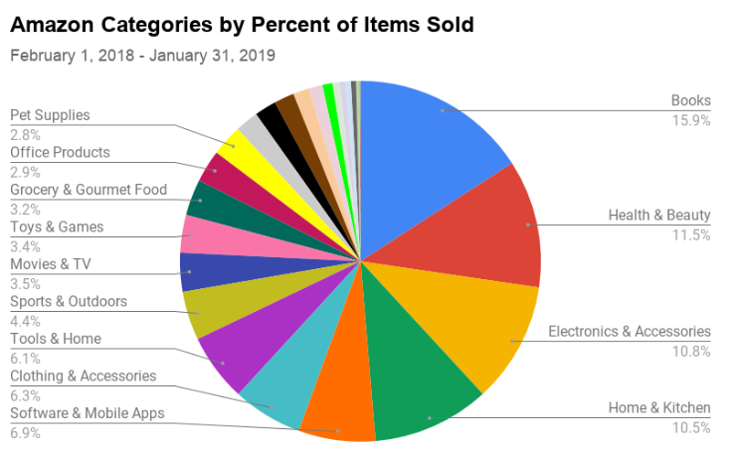
Category Overview - Electronics
Electronics, the third most sold category in
Amazon.com
Overall Products : 498K
Reviewed Products: 475K
Products with Price: 351K
# Reviewers : 4.2M
# Brands: 9905

Slide 7
Consumer Review Analysis - Electronics
Product
Rating
Higher the number of reviews for a product, higher is the reliability & credibility of the product
Number of reviews of the product sees a tremendous growth post 2010
89% of the products in Amazon.com has less than 20 reviews
2013 & 2014 has seen a large number of products with reviews greater than 100
Only 18 products were rated Low whereas 65% of products were rated High with number of reviews is greater than 300
Amazon.com shall consider reviewing the features of those products and introduce in their Private Label
Product Pricing
Price of the product never influences review & rating behavior of a product
Around 28% & 23% of the products in Electronics fall between a price range of $0 - $10 & $10 - $20 respectively
Though the most expensive products are rated 4&5 stars, the correlation is very weak r = 0.07
There is no significant difference in the average number of reviews of products across different price bucket
Reviewers put more time in reviewing products that are worth more, a strong correlation of 0.55 exists
MediaBridge, BlueRigger most famous brands with lesser products while Sony, SanDisk & Canon dominate with more products
Of the total 9905 different brands in Amazon.com, around 82% of the brands carry less than 10 products while 2.3% of the brands carry more than 100 products to their name
MediaBridge, BlueRigger and Crucial seems to be the most popular brands in different sub category of products with a very high ratings and reviews. Sony, Samsung, Canon who carry more than 500 products seems to dominant in the other segment of electronics
There isn’t any Brand that carries more than 100 products in their assortment that is rated Poor by customers
Amazon.com shall try introducing similar products from the top brands at different sub categories into their Private Label assortment
Brand
Loyal reviewers ratings adds more value to the business
Though the category has 4.2M reviewers only 4.2% of the reviewers have reviewed more than 5 products
Multi-time Reviewers hardly rate a product as Poor as compared to one time reviewers. Their average review length is around 1000 characters
Analyze the products that are rated poor by top 10 Trusted reviewers and study the sentiment of those products to understand the defective features and work towards improving them
Reviewer Behavior

Slide 8
Consumer Review Analysis

Slide 9
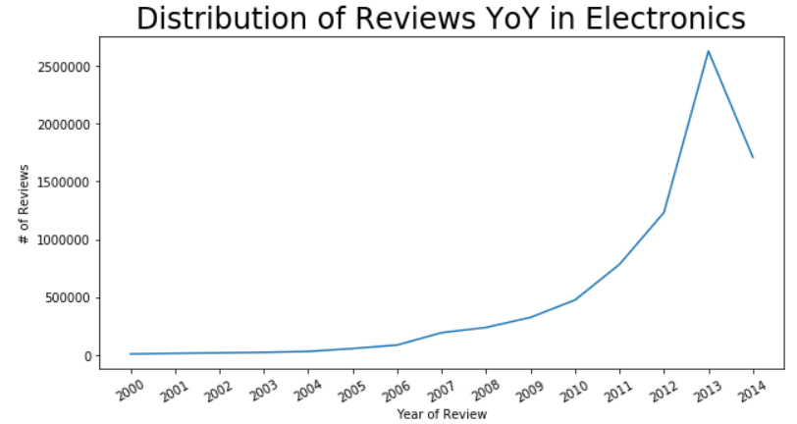
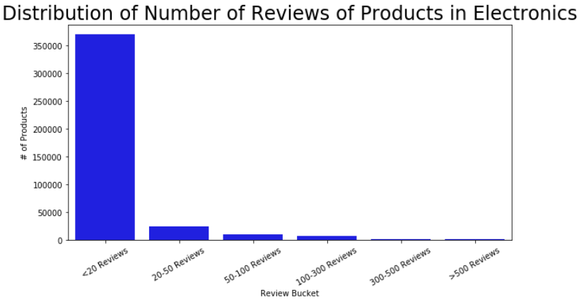
Higher the number of reviews higher is the reliability of the Product
Drastic increase in the number of reviews post 2010 and hence only products reviewed post 2010 taken into analysis – 414K products
89% of the products have less than 20 reviews – Average number of reviews for a product is 16
1
2

Slide 10
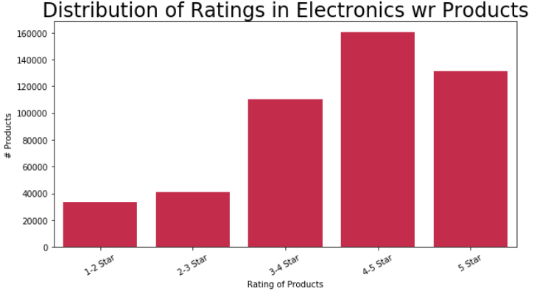
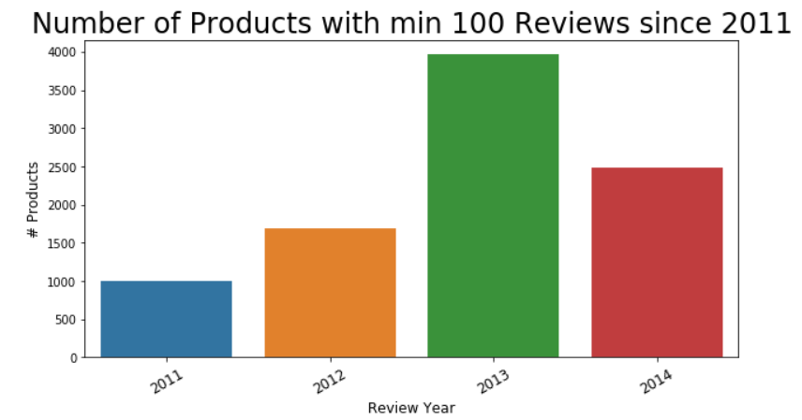
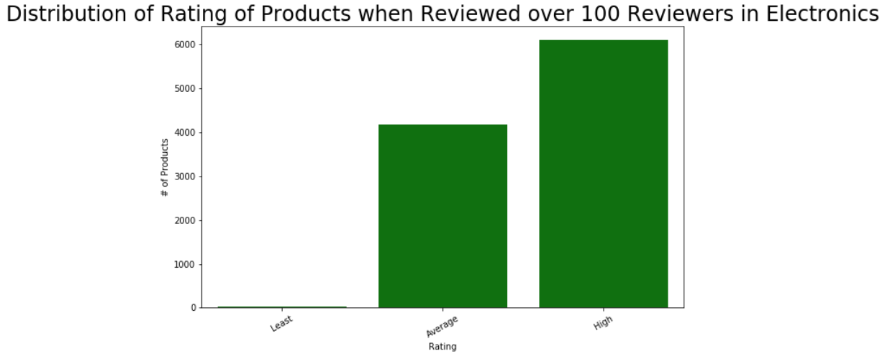
…contd
Least Rated – 1-2 Star , Medium Rated – 2-4 Star, High Rated – 4-5 Stars
More number of products with min 100 reviews since 2013
3
4
5

Slide 11
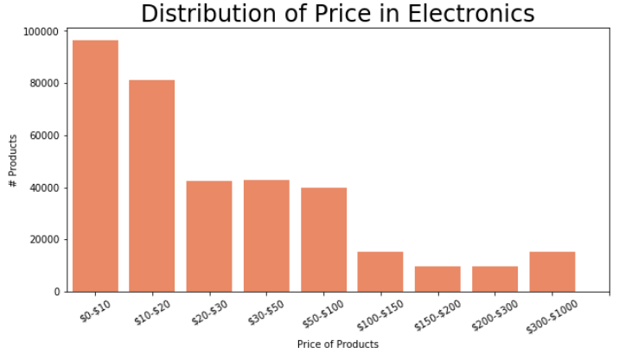
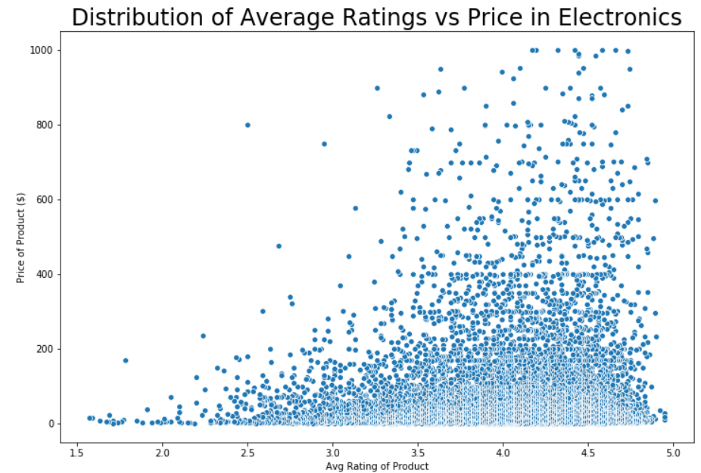
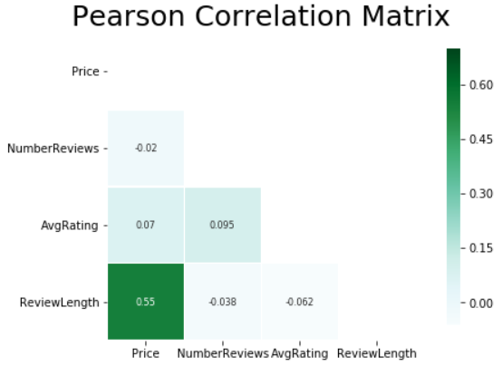
Influence of Price on Review & Rating
28% of products with price <$10 and 23% of products with price < $20
Strong correlation between Review Length and Price as compared to other attributes
Most expensive products have higher ratings
1
3
2

Slide 12
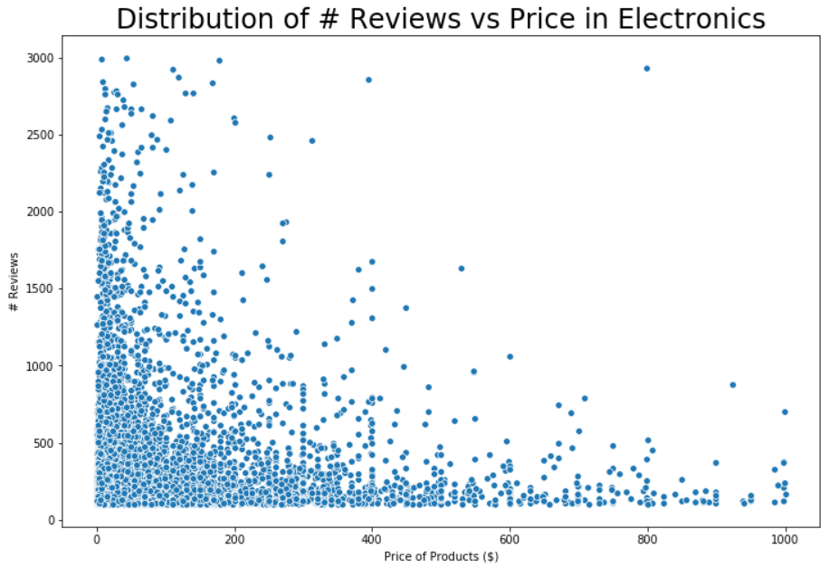
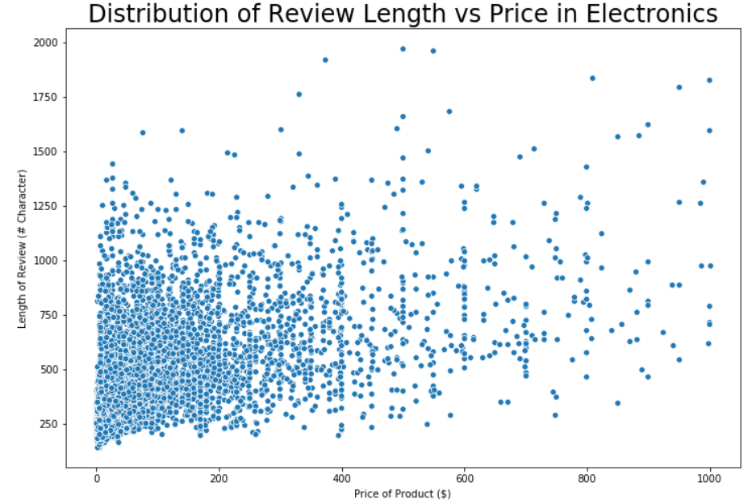
…contd
Though the number of reviews is more of products with lower price and vice versa, the average number of reviews doesn’t vary much across Price buckets
Reviewers put more time in reviewing products that are high priced. The average length of reviews increases with the Price bucket
4
5

Slide 13
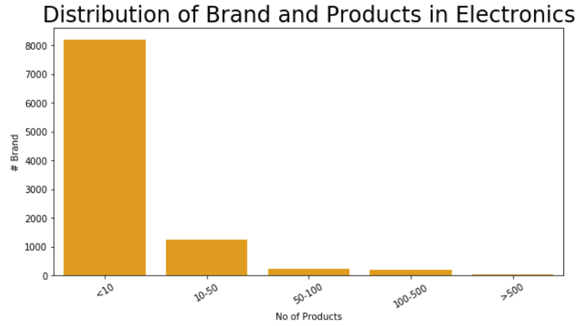
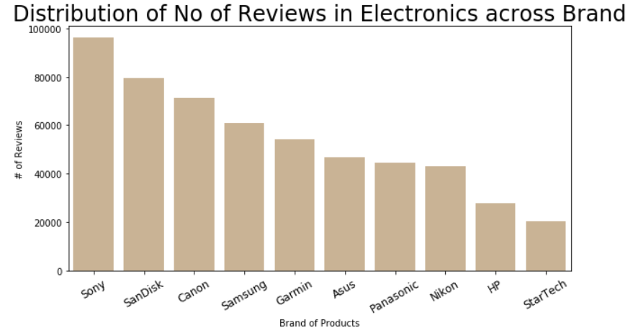
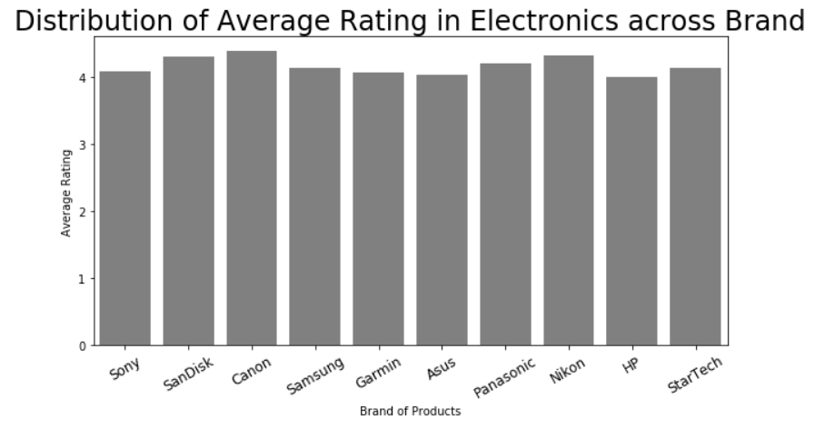
Performance of Brands
82% of brands have less than 10 products to their name
1217 Brands have 5 star rated products with a maximum of 13 reviews
Sony, SanDisk are the top brands carrying more than 500 products in Amazon with maximum reviews and high rating
1
2
3

Slide 14
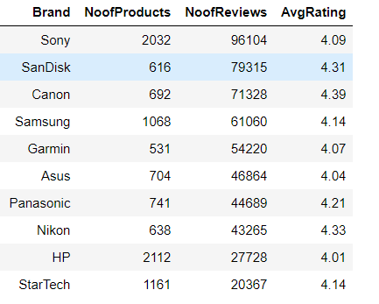
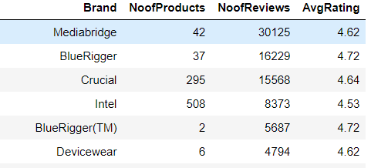
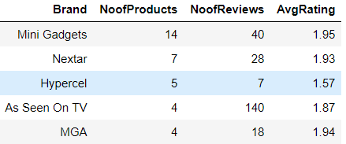
…contd
Top Reviewed & Rated Brand with more than 500 Products
Top Rated Brands
4
5
Least Rated Brands
6

Slide 15
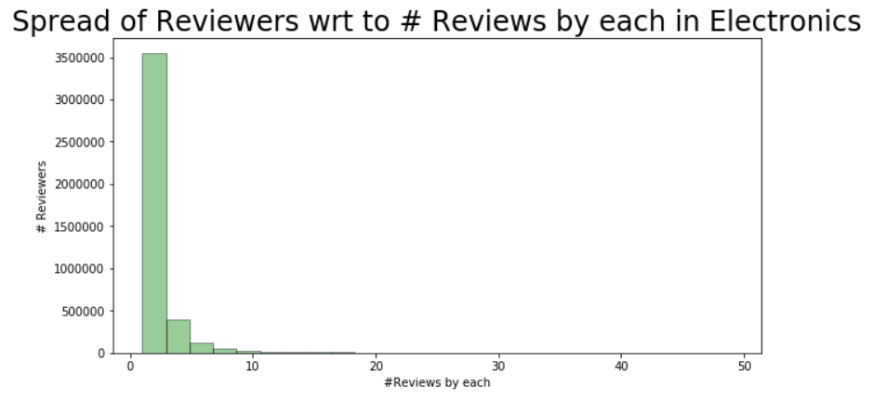
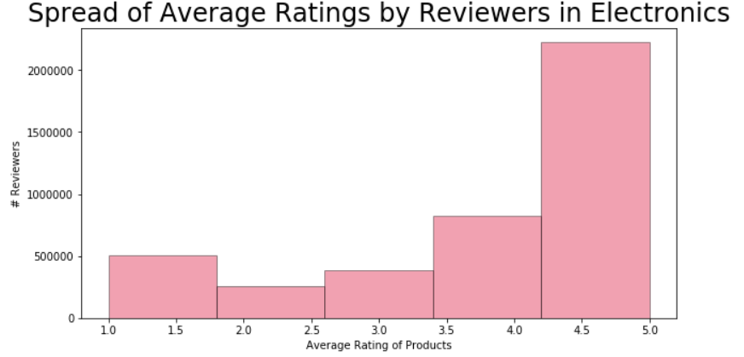
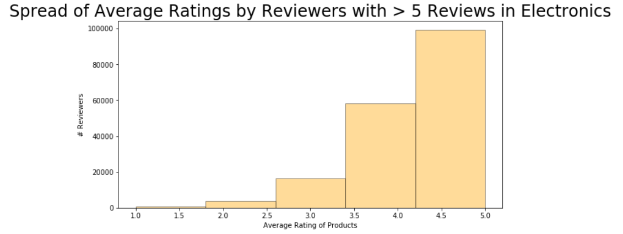
Reviewer Behavior
Of the total 4.2M reviewers, only 4.2% have reviewed more than 5 products
Repeat Reviewers hardly rate a product Low in Electronics category – Most least ratings are by One time reviewers
1
2
3

Slide 16
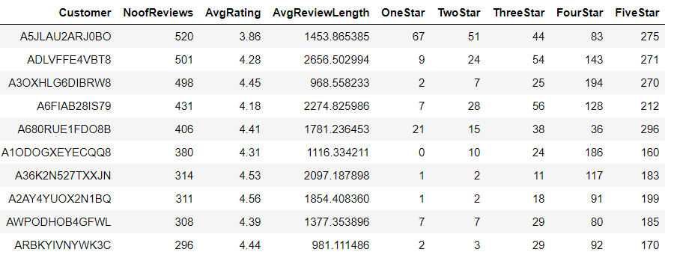
…contd
Loyal Reviewers spend more time in reviewing the products as their average review length is close to 1000 characters
Reviewing the least rated products by performing sentiment analysis will help uncover the issues/challenges faced by the customer and take measures to fix those
4
Loyal Reviewers with split of their ratings

Slide 17
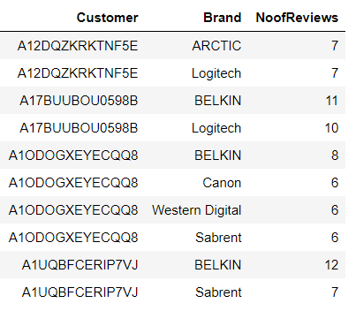
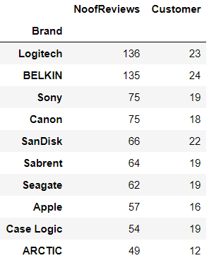
…contd
Dissecting the Loyal reviewers reviews in terms of Brands yields their most favorite brands
Also the most reviewed brand information by the pool of Top 25 reviewers. Investigating on the sentiment of reviews help improve the product
5
Top 25 Reviewers and their Top 2 reviewed brands
6
Top 10 Most Reviewed Brands by Top 25 Reviewers

Slide 18
Thank You!

Slide 19
Appendix

Slide 20
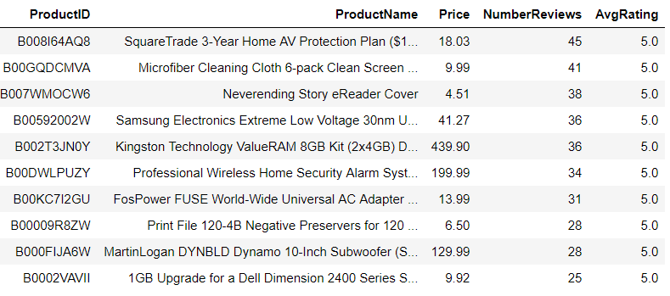
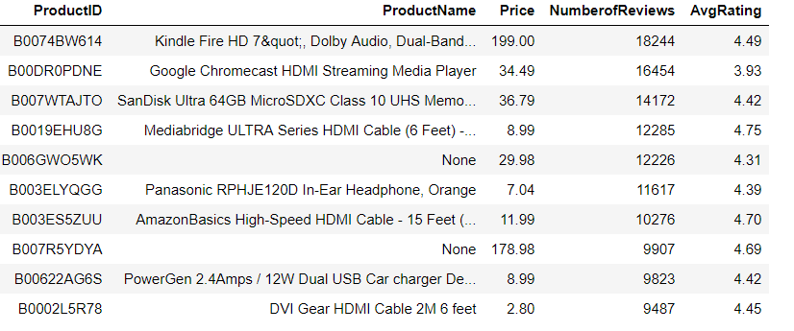
Top Rated Products with their corresponding number of reviews
Top Reviewed Products with their corresponding ratings

Slide 21
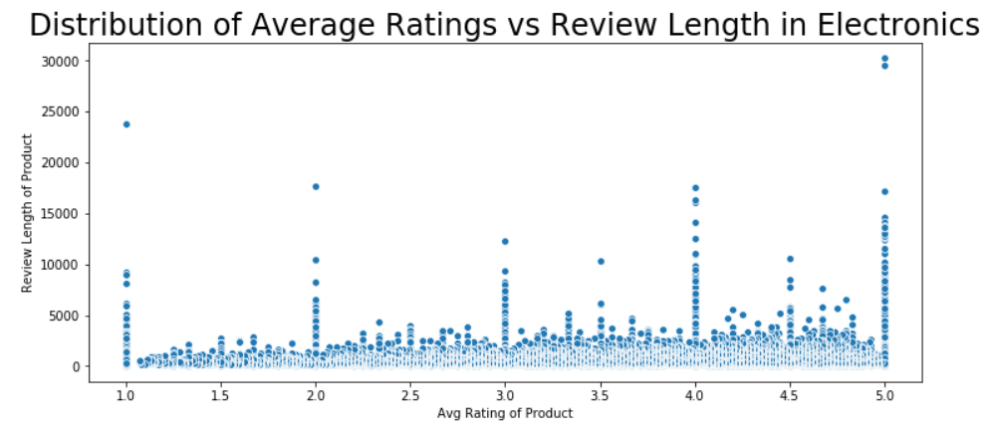
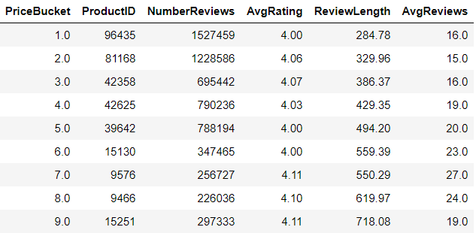
Key Review Metrics w.r.t Price Bucket

Slide 22
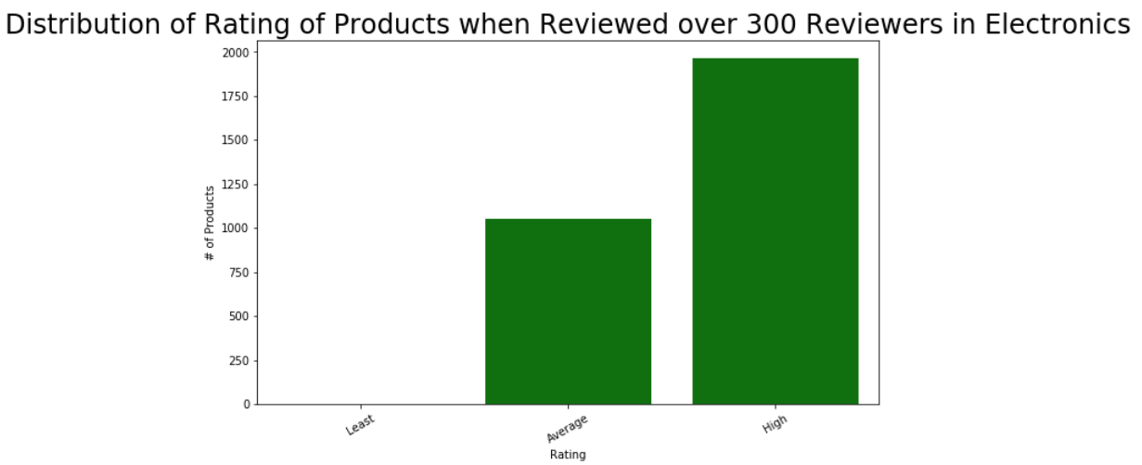

Rating Distribution of Products with over 300 reviews
Word Cloud of Negative Sentiment Features

Slide 23
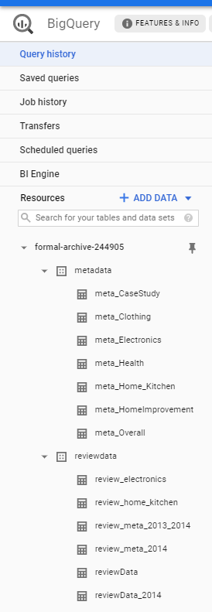
Data Ingestion Flow
1. Input File
Product Review Data (.gz)
Product Meta Data (.gz)
2. Upload File to GCP Bucket
Create a GCP account with proper credentials
Create buckets inside the project
Manually upload the files into buckets
3. Extract .gz File and Create Table
Extract the .gz file into buckets again using DataStore function
In Big Query, create Datasets to import the extracted data as Tables
Tables created in Big Query environment
4. Merge Tables to create input file
The Metadata table and review tables are merged on Product ID
All analysis is done on top of the merged table with required columns
5. Connect to Big Query through Python API
The Big Query tables are accessed from Desktop through Python API
Import the required libraries and set up API key in the desktop to enable the connection

Slide 24
Scope for Improvement
1. PySpark Environment
Since the file size is very huge, processing of all categories in local desktop is not feasible.
Run the code in SPARK environment through PySpark to improve performance
2. Integration with Tableau
As the data is available in Big Query platform, dashboards can be created in Tableau by creating live connection
with tables
3. Perform Sentiment Analysis on the reviews
Performing Sentiment Analysis on the reviews of the products
Deep dive into the negative sentiment products
Study the feature of the products

